Slide 1
Learn by doing
30 AUGUST 2014
CONFIDENTIAL
Notes:
<number>

Slide 2
Ruby && JavaScript
Learning
Trying
Making it happen
Notes:
<number>

Slide 3
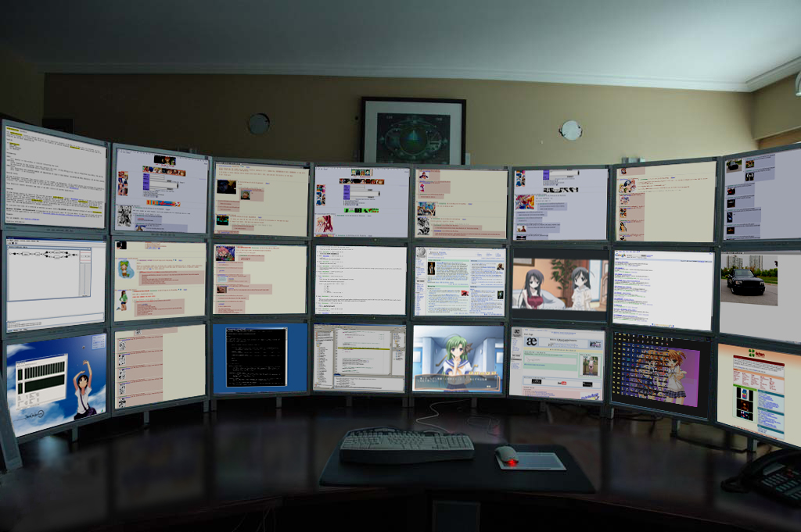
Ruby on Rails - first impression
Notes:
<number>

Slide 4
Ruby on Rails, road trip
Agile Web Development with Rails – Fourth edition
Introduction to Rails and Ruby
Introduction to MVC
Introduction to Git
First application in Ruby on Rails
Notes:
<number>

Slide 5
Ruby on Rails, road trip
Bill Application
Interaction with the client
Making tasks
Deadline
Daily status to the client
Deploying the application

Slide 6
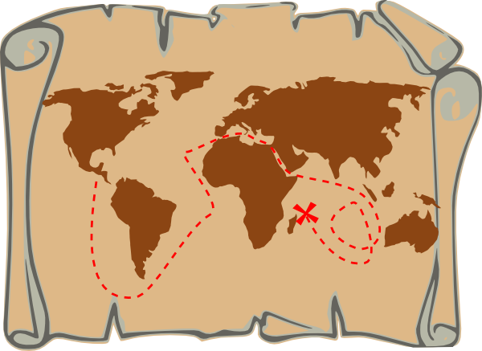
JavaScript, First stop: HTML, CSS

Slide 7
JavaScript, road trip
CodeAcademy
Tasks with Assana
'JS personal Blog'
HTML, CSS – CV
2048 with JavaScript
Notes:
<number>

Slide 8
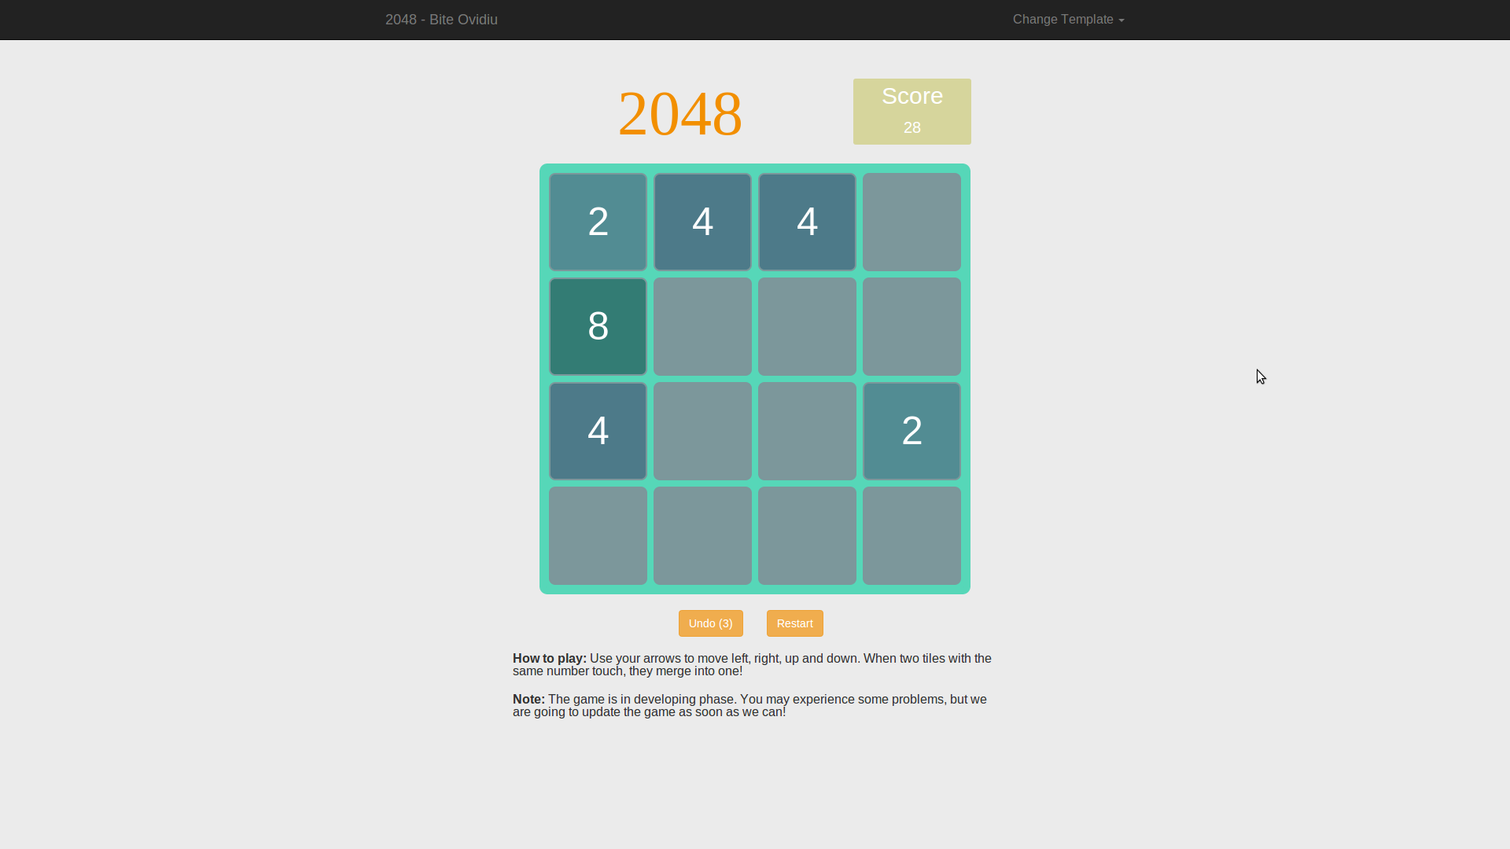
2048 with JavaScript

Slide 9
2048 with JavaScript
3 Steps:
Make the Gameplay rules
Implement the logic
Make it fancy

Slide 10

Gameplay rules: BrainStorming

Slide 11
2048 with JavaScript
Logic:
Create a Tile object
Create a matrix that contains Tiles
Do 'magic tricks' (insert tiles, move, draw and other functions)

Slide 12
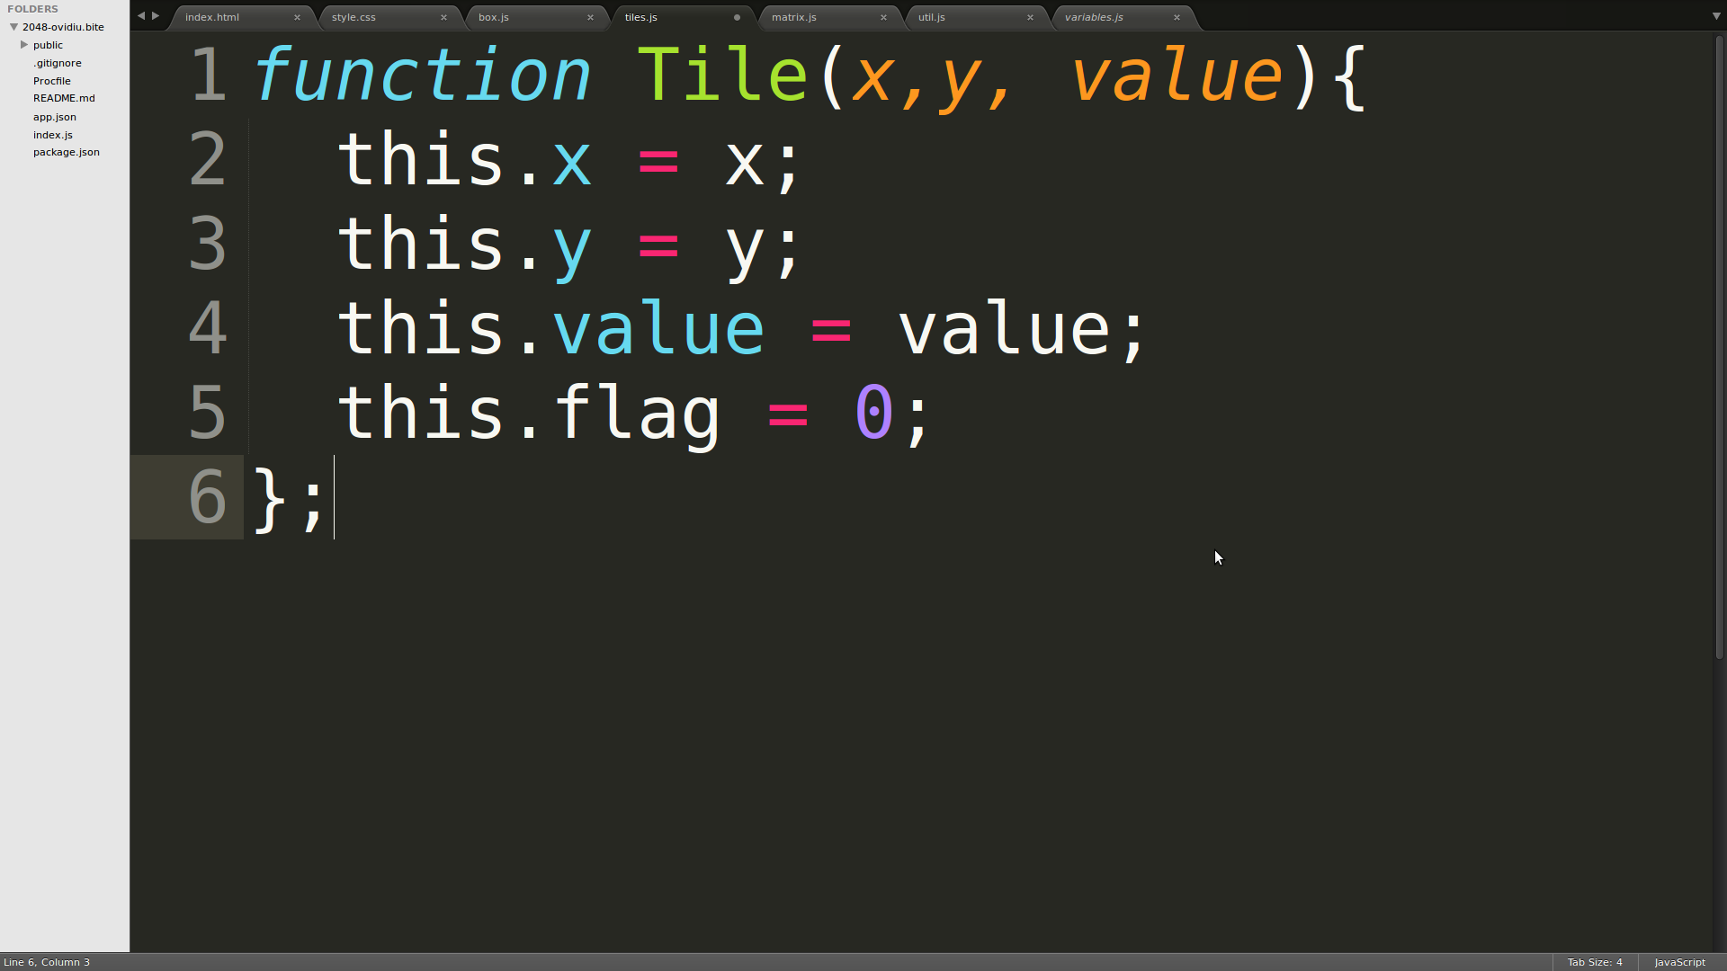
2048 with JavaScript
Coding:
createMatrix function
Tile object:
startGame function:
Initialize the matrix with tiles with value = 0, and 2 tiles with value = 2;

Slide 13
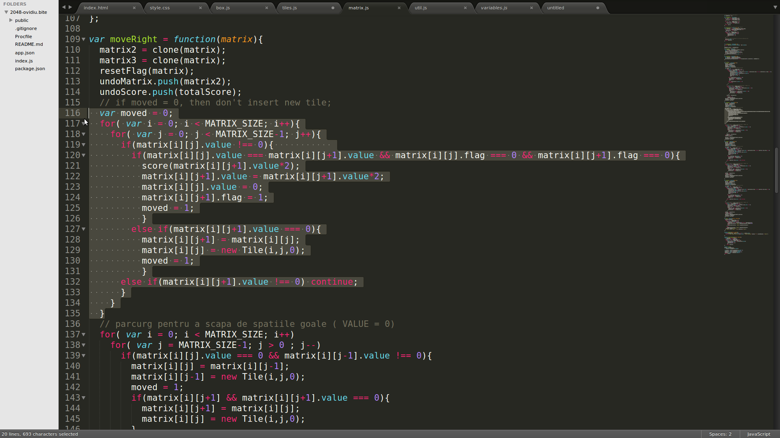
2048 with JavaScript
Coding:
Move right:

Slide 14
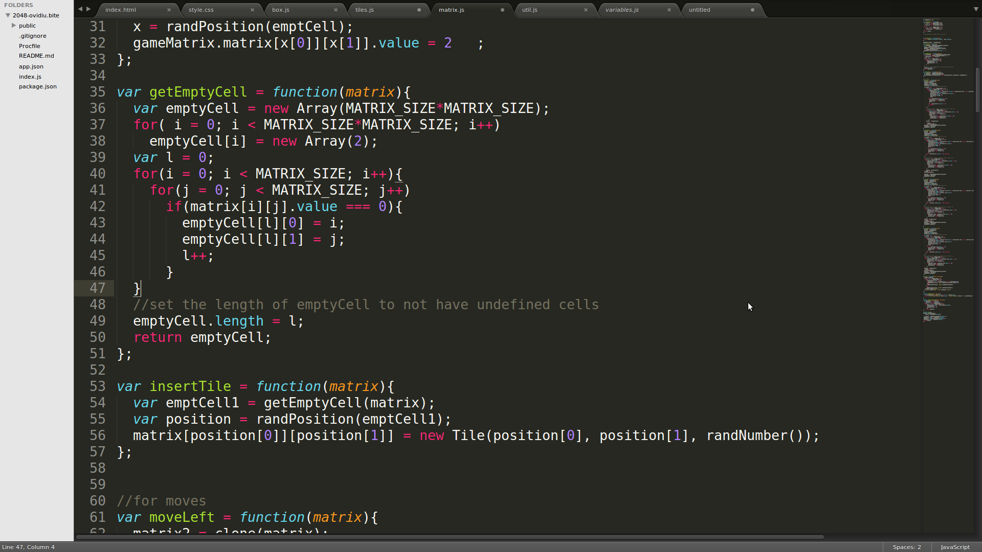
2048 with JavaScript
Coding:
Inserting a new Tile if we make a move with insertTile function
insertTile function:
GetEmptyCell function:
Create a matrix with the positions where we have empty tiles ( value = 0 );

Slide 15
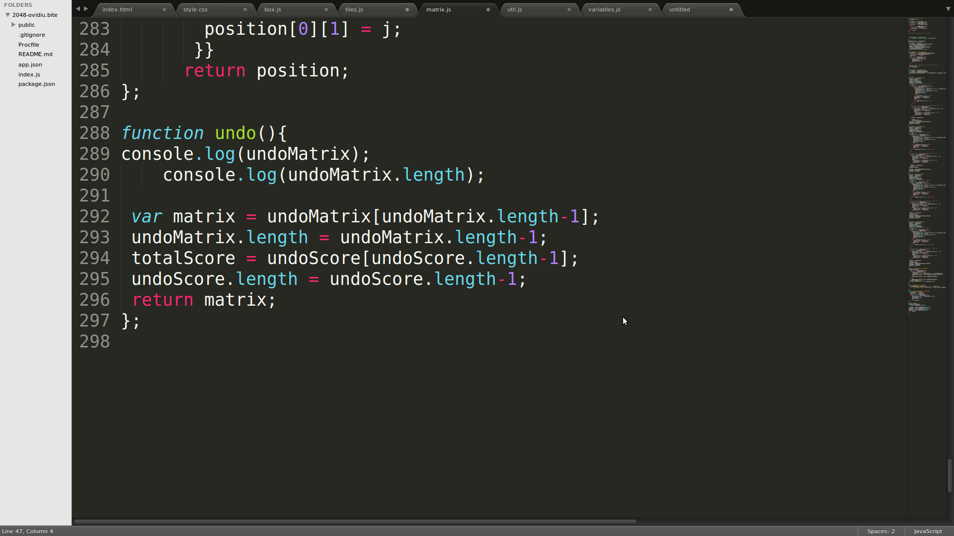
2048 with JavaScript
Coding:
Undo function:
Can undo x moves.

Slide 16
2048 with JavaScript
Coding:
jQuery library helped me to add some visual effects. Some functions:
FadeIn() effect for new tiles and for game messages (game over, win);
.append(), AppendTo() for adding new html;
Keydown() for movement;
Click();

Slide 17
2048 with JavaScript
Other Useful Tools
NodeJS: preparing the app for deploying to heroku;
Codeship for deploying project to heroku from github;
LocalStorage for saving game progress;

Slide 18

Notes:
<number>

Slide 19
Let's play
2048
Notes:
<number>

Slide 20
Thank you!
Notes:
<number>

